Slide 1

ServiceStack.Net
An introduction sdg COP demo

Slide 2
Paul Thompson
Consultant, SDG
@paladincoder
paul.thompson@solutiondesign.com
http://www.solutiondesign.com

Slide 3
What is ServiceStack.Net?
REST Web Service Framework
.NET and MONO
Web Services done right, REST services done easy

Slide 4

Web Service History
EDI
XML RPC
SOAP / REST
ServiceStack
???
Actual History: http://www.w3.org/2002/ws/history.html

Slide 5
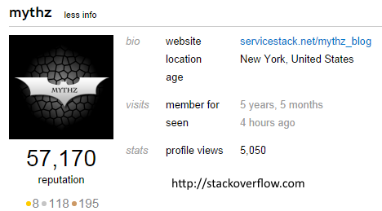
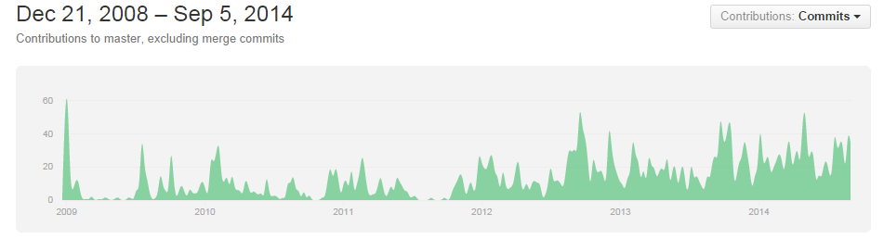
Servicestack History
Invented and maintained by Demis Bellot, and servicestack team
Started as open source, #2 github project in 2013
Very active

Slide 6


Slide 7
Design Goals
Simplicity
Speed
Best Practices (Remote Services and Code)
Model-driven, code-first, friction-free development
Fuse C# and HTTP as DRY as possible
Write once, support for all XML, JSON, SOAP...
No XML Config, No Code-gen
Smart. Infers intelligence from strong-typed DTOs
First class cross-platform support for OSS/Linux

Slide 8
Simple
C# Model-driven development,
Define Web Service API using YOUR strong-typed DTOs
No Code-gen
No Artificial layers or constructs
Complete control over HTTP Headers and serialized output
Endpoint ignorant
C# only, code to interfaces and types not specific formats or endpoints
C# object IN -> C# object OUT
No config required with Sensible defaults
No code-gen, same DTO used in strong-typed client API
Same C# client can call any web service at any endpoint
Generic C# Service Clients: XML, JSON, JSV and Soap11/Soap12
Both Sync and Async clients support 1 LOC web service calls
Provides ErrorCode, ErrorMessage from WebServiceException

Slide 9

Demo
You had me at hello

Slide 10

Fast
Built on raw IHttpHandlers
No runtime reflection or regular expressions
Uses Built-in Funq IOC
Funq is 55x faster than Windsor
Fastest JSON, JSV text serializers for .NET
ServiceStack.Text is 3.6x faster DataContractJsonSerializer
Includes #1 C# Redis Client
Redis is the fastest in-memory NoSQL database
Includes ASP.NET config-free caching providers
Memcahed
Redis
In-Memory
FileSystem

Slide 11

Best Practices
Influenced by Martin Fowlers Data Transfer Object Pattern
Encourage batch-full, re-usable web services
Discourage chatty, client-specific APIs
Importance of a Coarse-grained, well-defined API
Resilient serializers with better versioning support
Decoupling of message from operation and endpoint
Clean separation of DTO from implementation

Slide 12
C# and HTTP as DRY as possible
Develop Service using only C# POCO types
Same service with no config or code-gen
Callable via REST, RPC POX/J or SOAP endpoints
Callable on any format (XML, JSON, SOAP, JSV, CSV, HTML)
Can process HTTP File Upload multipart/form-data
Strong-typed Request DTO can be populated by:
HTTP GET QueryString, HTTP POST DTO Content-Type (i.e. XML, JSON, etc), HTTP FORM POST x-www-form-urlencoded
Can return any of:
Any DTO object -> serialized to Response Content-Type
HttpResult, HttpError for Customized HTTP response
String, Stream, IStreamWriter

Slide 13
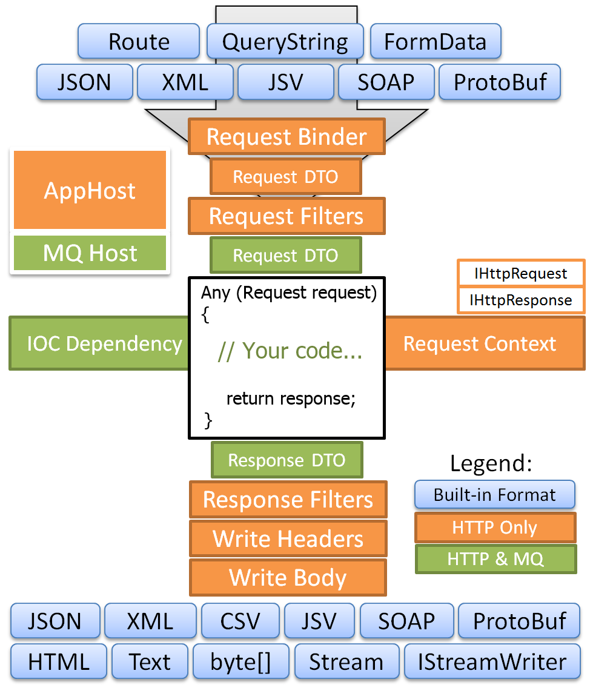
Architecture
POCO Based messaging
Request/Response or Message Queuing
Built on top of Raw ASP.NET IHttpHandler

Slide 14
“No” Config
Very little web.config work required with acceptable defaults
Connection strings
Http handler declaration
Additional 3rd party library configuration
Routes are all handled by POCO attributes

Slide 15
Smart - Infers from service metadata
Serializes C# Exceptions into your Response DTO
Auto-generated web services metadata api page
Links to XSDs and WSDLs
Auto HTML5 JSON Report format
Quickly visualize web service data at a glance
Generates a self-contained snapshot of web service data in a human-friendly and programmatically accessible document
Auto CSV format
Picks best candidate property to serialize into CSV resultset

Slide 16
Cross platform - Run in .NET and MONO
Supports both ASP.NET and HttpListener hosts:
Runs on Windows with .NET 3.5, 4.0, 4.5
IIS 6/7+ (uses IHttpHandler)
VS.NET WebDev server
Console App or Windows GUI
Windows Service
Linux/OSX with MONO
Apache + mod_mono
Nginx + MonoFastCGI
XSP
Console App
Haz demo running inside iOS with MonoTouch :)

Slide 17
DEMO

Slide 18
Questions?

